Slide 1
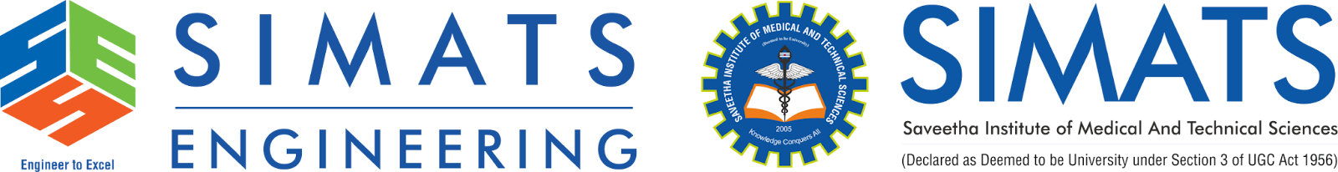
Technical Presentation
Mobile Operating Systems – Architecture Overview
BY
k.jaya venkata sai
192525182
Supervisor
Dr.S.Sundar Rajan
Professor

Slide 2
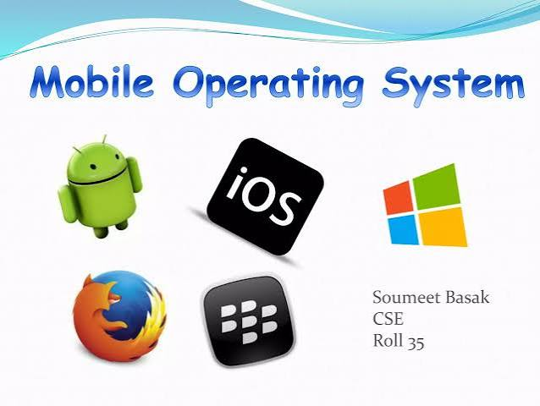
Introduction
What is a Mobile Operating System?
A Mobile Operating System (Mobile OS) is system software that manages the hardware and software resources of smartphones, tablets, and wearable devices. It provides an interface between users, applications, and device hardware.
Examples
Android
iOS
windows
HarmonyOS
KaiOS

Slide 3

Features of Mobile Operating Systems
Touchscreen support
Multitasking
Application management
Internet connectivity
Security and privacy
Power management
Multimedia support
GPS and location services

Slide 4
Mobile OS Architecture
Applications
│
▼
Application Framework
│
▼
Runtime Environment
│
▼
Native Libraries
│
▼
Linux Kernel
│
▼
Hardware
Explanation:
Applications interact with users.
Framework provides APIs.
Runtime executes applications.
Libraries provide system functions.
Kernel manages hardware resources.

Slide 5
Android Architecture Components definition
Android Component | One-Line Definition
Applications | The top layer that contains user applications such as WhatsApp, Chrome, and Gmail.
Application Framework | Provides APIs and system services that help developers build Android applications.
Android Runtime (ART) | Executes Android applications and manages memory for efficient performance.
Native Libraries | A collection of C/C++ libraries that provide core functions like graphics, media, and database support.
Linux Kernel | The core layer that manages hardware, memory, processes, security, and device drivers.

Slide 6
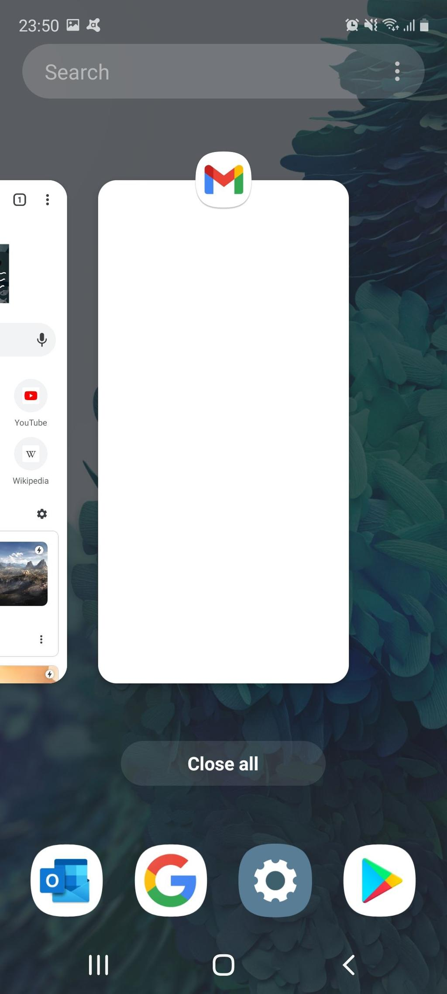
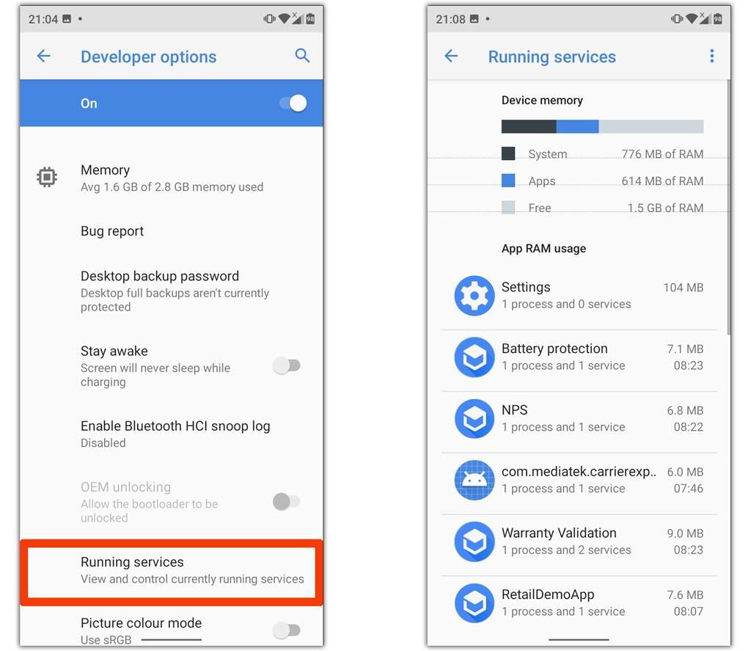
Process Management
Responsibilities
Process Creation
Scheduling
Multitasking
Background Services
Process Termination
Example
When switching from WhatsApp to Chrome, the OS saves the WhatsApp process and allocates CPU resources to Chrome.

Slide 7
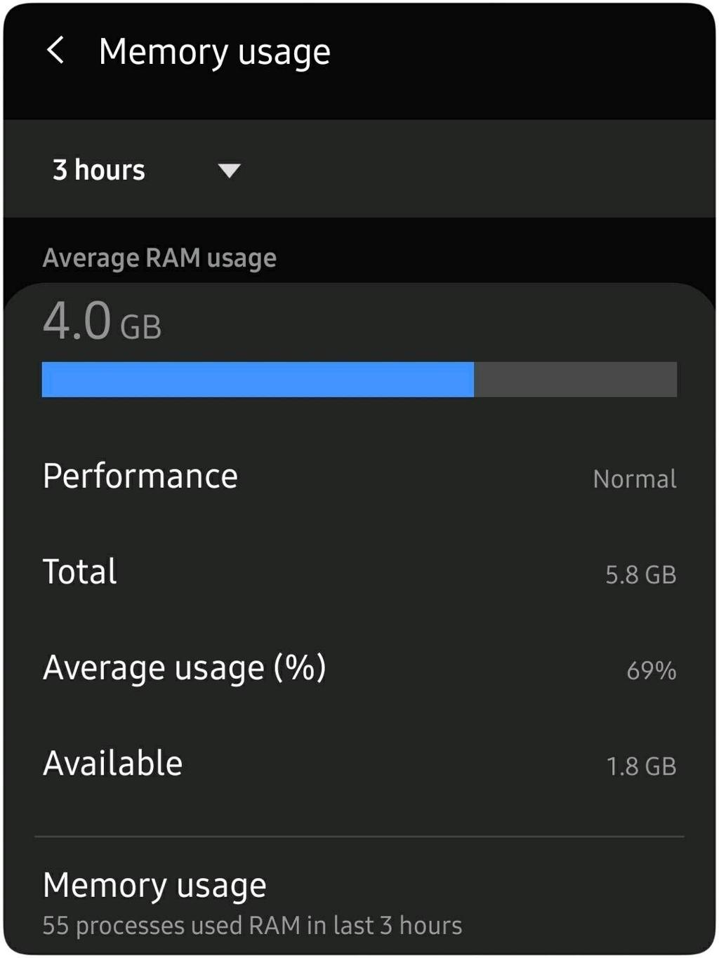
Memory Management
Functions
RAM Allocation
Virtual Memory
Garbage Collection
Cache Management
Benefits
Faster Performance
Efficient Resource Usage
Reduced Crashes

Slide 8
Security Features
User Authentication
Application Sandbox
Data Encryption
Permission Management
Secure Boot
Biometrics (Face ID/Fingerprint)
Advantages
User-friendly Interface
Efficient Resource Management
Better Security
Power Optimization
Supports Millions of Applications
High Performance

Slide 9
Difference between operating systems and android
Operating System (OS) | Android
A general software that manages computer or device hardware and software. | A specific mobile operating system developed by Google.
Used on computers, laptops, servers, phones, and embedded devices. | Mainly used on smartphones, tablets, TVs, and smartwatches.
Examples: Windows, Linux, macOS, Android, iOS. | Android is one example of an operating system.
Can be desktop or mobile. | Specifically designed for mobile devices.
May use different kernels depending on the OS. | Built on the Linux kernel.
Supports various hardware platforms. | Optimized for touchscreens, mobile processors, cameras, GPS, etc.

Slide 10
Comparision of Android vs iOS
Feature | Android | iOS
Kernel | Linux | XNU
Source | Open Source | Closed Source
App Store | Google Play | Apple App Store
Programming | Java, Kotlin | Swift, Objective-C
Customization | High | Limited
Security | Good | Very High

Slide 11
Conclusion
Mobile Operating Systems manage hardware and software resources efficiently.
Android and iOS are the most widely used mobile operating systems.
Their layered architecture improves modularity, security, and performance.
Future mobile operating systems will become more intelligent, secure, and energy-efficient.

